Slide 1
Their income gap is your income gap
What is the great retirement income gap?
For use with financial professionals and/or attorneys only. Not for public distribution.
PM-1200 19-01573

Slide 2
Disclosures Please take a moment to review
Products are issued and underwritten by The State Life Insurance Company® (State Life), Indianapolis, IN, a OneAmerica company that offers the Care Solutions product suite. Asset Care Form number: L301 and R501 and SA3. Annuity Care Form number: SA35, SA34 and R508. Not available in all states or may vary by state. Guarantees subject to the claims paying ability of the issuing insurance company.
Provided content is for overview and informational purposes only and is not intended as tax, legal, fiduciary or investment advice. All numeric examples are hypothetical and used for explanatory purposes only. All factors should be weighed before replacing an existing life insurance or annuity.
NOT A DEPOSIT • NOT FDIC OR NCUA INSURED • NOT BANK OR CREDIT UNION GUARANTEED •
• NOT INSURED BY ANY FEDERAL GOVERNMENT AGENCY • MAY LOSE VALUE
For use with financial professionals and/or attorneys only. Not for public distribution.

Slide 3
Preparing for Retirement
For use with financial professionals and/or attorneys only. Not for public distribution.
Notes:
There are so many things to consider on your journey toward retirement.

Slide 4
Accumulation phase
Distribution Phase
(RETIREMENT YEARS)
(WORKING YEARS)
For use with financial professionals and/or attorneys only. Not for public distribution.
Notes:
What’s the goal in mountain climbing? Most would say to get to the top but it’s really to get back down successfully.
Most baby boomers have reached the top of the mountain, completing the “accumulation phase” of retirement. Now they’re beginning to retire and enter the “distribution phase.” This is why we’re seeing a lot of focus now on income and income strategies. Make sure your clients pack all the provisions they need to ensure a successful, secure descent.

Slide 5
Get successfully down the mountain Issues that can impact the descent
Having enough income
Low interest rate market
Healthcare costs
Long-term care costs
For use with financial professionals and/or attorneys only. Not for public distribution.
Notes:
Everyone needs a plan to successfully get down the mountain. Certain obstacles can send you on detours or halt your descent altogether. These issues and obstacles can include:
Having enough income to sustain you in retirement
The low interest rate market
Rising healthcare costs
And having enough income to pay for long-term care

Slide 6
Costs of long-term care? Average costs in 2017
$97,452 per year for private room in 2017*
3.5% medical inflation rate
$137,465 per year in 10 years; or
$193,908 per year in 20 years
X
Source: “Genworth 2017 Cost of Care Survey, conducted by CareScout®, June 2017
https://www.genworth.com/about-us/industry-expertise/cost-of-care.html Website accessed 16 October 2017.
For use with financial professionals and/or attorneys only. Not for public distribution.
Notes:
The average cost for one year in a private room in a nursing home was over $97,000 in 2017.
Keep in mind that averages are middle-of-the-road projections. Half of people will need less, while the other half will need more.
The current rate of inflation is around 4-6%, but let’s factor in a conservative rate of 3.5%. That $97,000 today can turn into nearly $194,000 in 20 years.

Slide 7
Understand the trends What can impact long-term care costs?
1
3
Higher demand
Number of people needing care at the same time
Family dynamics
Who is providing care now?
2
4
Longer life spans
Life expectancy increasing – costs more
Government
What programs will be available? Who will qualify?
For use with financial professionals and/or attorneys only. Not for public distribution.
Notes:
1. Higher demand. As our population ages, demand for long-term care services increases. Higher demand leads to higher costs.
2. Longer life spans. Advances in medical technology are helping us live longer, but as access to these new technologies increases so too does the cost to use them.
3. Family dynamics. Most parents don’t want their children putting their lives on hold to provide care. And if they did, will the care responsibilities be spread equally among the children? Probably not.
4. Government. Which of today’s programs will be available in the future? Who will qualify, and how?

Slide 8
Another trend… Alzheimer’s disease and long-term care
About 5.5 million Americans age 65+ have Alzheimer’s disease in 2018, which is 1 in every 10 people above 65.*
By midcentury, someone in the U.S. will develop the disease every 33 seconds.*
*Source: 2018 Alzheimer’s Disease Facts and Figures. Alzheimer’s Association. https://www.alz.org/media/HomeOffice/Facts%20and%20Figures/facts-and-figures.pdf, pages 17 and 22. Web. 2018.
For use with financial professionals and/or attorneys only. Not for public distribution.
Notes:
Each of the trends we just discussed can have a significant impact on another emerging trend: Alzheimer’s, a degenerative disease that impacts memory and other mental functions. There is no cure, and the disease often requires long-term care services for an extended period.
There were an estimated 5.5 million Americans age 65+ with Alzheimer’s in 2018.
These numbers will increase rapidly in the coming years due to the Baby Boomer generation. By 2050, the number are expected to nearly triple from 5.5 million to 13.8 million.
1 in 10 people over 65 currently has Alzheimer's and by mid-century, someone in the US will develop the disease every 33 seconds.

Slide 9
Consider this $193,908* per year can become…
 | Average Length of LTC Stay | Total
Men | 2.2 years¹ | $426,597
Women | 3.7 years¹ | $717,459
Alzheimer’s | 8 years² | $1,551,264
*Calculated as cost of one year of care in a private room ($97,452) experiencing 3.5% inflation over 20 years.
^{1.} How Much Care Will You Need?” LongTermCare.gov. U.S. Department of Health and Human Services. https://longtermcare.acl.gov/the-basics/how-much-care-will-you-need.html. 23 July 2018.
^{2.} Alzheimer’s Association. 2018 Alzheimer’s Disease Facts and Figures. Alzheimer’s Association. https://www.alz.org/media/HomeOffice/Facts%20and%20Figures/facts-and-figures.pdf, page 28. Web. 2018.
For use with financial professionals and/or attorneys only. Not for public distribution.
Notes:
Let’s put that $194,000 into perspective. That cost is for just one year. When you consider the average length of stay, 2.2 years for men and 3.7 years for women, the cost of an entire stay in a private room can exceed $700,000.
And remember the prevalence of Alzheimer’s? The average care need, post-diagnosis, is around 8 years which can cost $1.5 million. And some Alzheimer’s patients can live up to 20 years post diagnosis.
The only way to hedge against these astronomical expenses is planning for a possible long-term care need.

Slide 10
Who needs care? Statistics that matter
An American turning 65 today has a nearly 70% chance of requiring of LTC services in their lifetimes.
And of those needing care, 20% will need it for longer than five years.
70%
20%
Source: https://longtermcare.acl.gov/the-basics/how-much-care-will-you-need.html Web. Accessed March 25, 2019.
For use with financial professionals and/or attorneys only. Not for public distribution.
Notes:
An American turning 65 today has nearly a 70% chance of requiring some form of long-term care services in their lifetimes.
And of those needing care, 20% will need it for longer than five years.

Slide 11
What is long-term care?
Different meanings
Statistics?
Facilities?
Emotional conversations?
For use with financial professionals and/or attorneys only. Not for public distribution.
Notes:
What is long-term care? Scary statistics, items like wheelchairs, services like home health care, facilities like nursing homes?
Yes… these items are related to LTC, but…

Slide 12
LTC is simply…
Another bill to pay
Another retirement expense that causes their income needs to increase, and…
The income required to cover this retirement expense.
For use with financial professionals and/or attorneys only. Not for public distribution.
Notes:
LTC is simply another retirement expense, another bill to pay. And expenses impact income in retirement.

Slide 13
Questions to ask Explaining the concept to your clients
“In your retirement years, what could cause your expenses to outweigh your income?”
For example, you are living well on $200,000 per year. One day you call me to say you need to begin taking out an additional 50-70% more every year in addition to the $200,000 you’re already using.
What might happen in your life to cause this situation?
For use with financial professionals and/or attorneys only. Not for public distribution.
Notes:
When discussing this concept with your clients, it helps to start with this question: In your retirement years, what could cause your expenses to outweigh your income?

Slide 14
The realization How can they find that additional 50-70% each year?
This is the great retirement income gap.
For use with financial professionals and/or attorneys only. Not for public distribution.
Notes:
What can you expect to hear from your clients? Most clients will know that a health issue can cause them to become frail and need care.
How could they, or YOU, find that additional 50-70% each year?

Slide 15
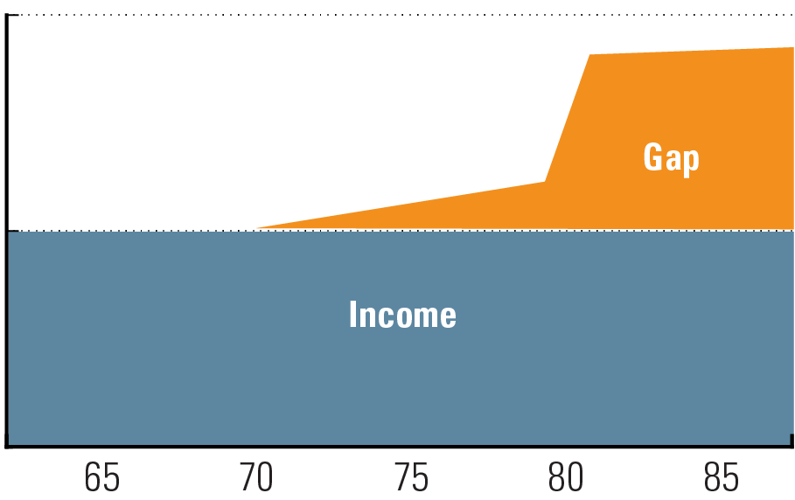
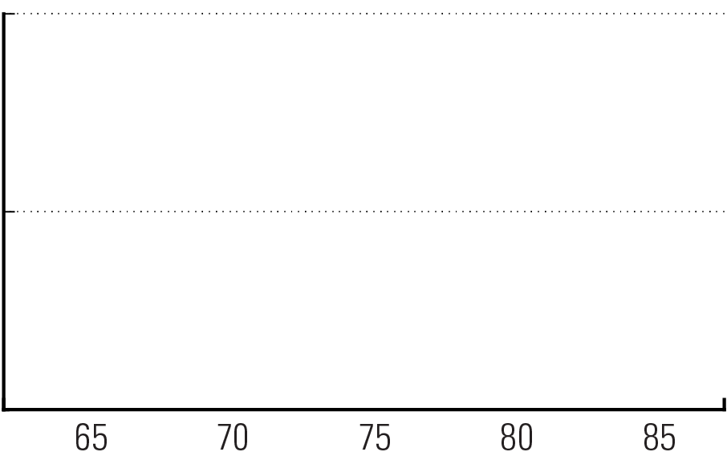
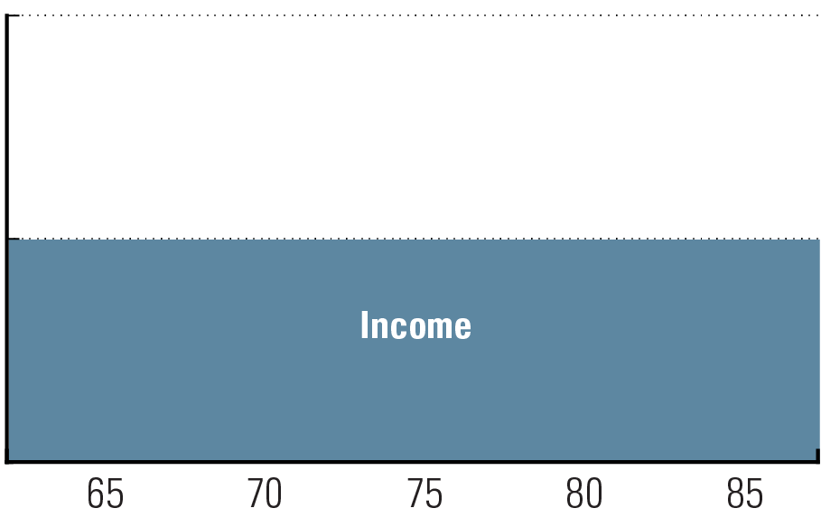
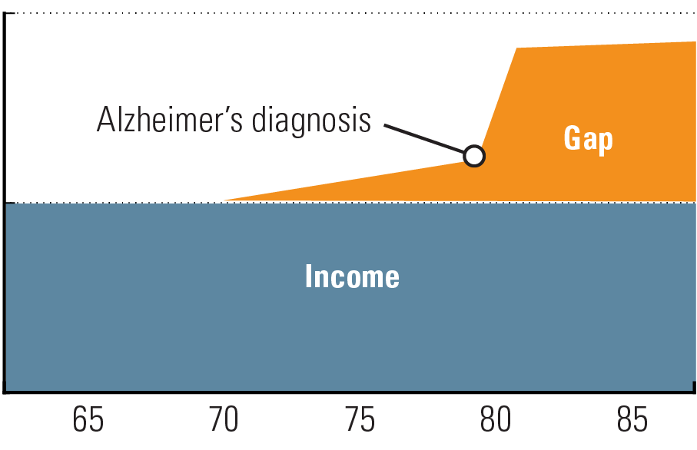
The great retirement income gap When expenses exceed income
Expenses
$
0
Retirement age
For use with financial professionals and/or attorneys only. Not for public distribution.
Notes:
An income gap exists when your expenses exceed your expected income.
In this example, you could be living comfortably on $100,000 a year.
But what if your income needs suddenly skyrocketed?
An Alzheimer’s diagnosis can cause widen the gap even further.

Slide 16
Their income gap is your income gap Imagine 70% of your clients needing LTC
How could your clients’ sudden need for additional income affect you?
The faster clients withdraw assets under your management, the less money you have in turn.
Long-term care is an income problem
not an asset problem.
For use with financial professionals and/or attorneys only. Not for public distribution.
Notes:
If 70 percent of your clients needed to find an extra $50,000-$70,000 a year to cover unexpected expenses, would you be worried? This is just what would happen if they face the retirement income gap, jeopardizing the income strategy you’ve worked with them to create.
If your clients aren’t prepared for the retirement income gap, they’ll likely have to spend down their assets much faster than planned. Have you thought about how this would affect your business?

Slide 17
Paying for care 3 ways to go
Government Government programs, such as Medicaid, may require them to spend down their assets first.
Self funding Requires them to pay out-of-pocket for all expenses. This means paying dollar-for-dollar and could potentially wipe out everything that has been worked for and saved.
Long-term care insurance In many cases, traditional LTCi can be very expensive, hard to qualify for, and to many, viewed as a “use it or lose it” policy.
For use with financial professionals and/or attorneys only. Not for public distribution.
Notes:
Read slide

Slide 18
3 night hospital stay within 30 days of entering nursing home
Nursing home entered for same reason has hospital stay
Care must be skilled
Care must be rehabilitative with ascertainable goals
Limited to 100 days of coverage (new period if 60 days without hospital or skilled care)
Medicare Busting the myths
For use with financial professionals and/or attorneys only. Not for public distribution.
Notes:
Medicare is an entitlement program that provides a health insurance plan for people age 65 and older, and for the disabled. Many people mistakenly believe Medicare will cover long term care costs, but as this slide reveals, the coverage Medicare provides for LTC is limited.

Slide 19
Income and asset tests ($2,000 assets for single)
For spouses: the assets of both, the income of applicant only (certain assets not countable)
Spousal impoverishment and spend down
Half up to $123,600 ($247,200) in 2018
5 year (60 month) look back on assets transferred for less than fair market value
Medicaid facility requirements
State liens to recoup benefits paid
Medicaid Busting the myths
For use with financial professionals and/or attorneys only. Not for public distribution.
Notes:
Medicaid, unlike Medicare, is not available to everyone because it is a means tested program. It can pay for skilled and rehabilitative care, is funded by the state and federal governments, is administered by the states, and covers custodial care but primarily in skilled nursing facilities. It is not the purpose of this presentation to provide an extensive discussion of Medicaid. The rules can vary from state to state, and an analysis of whether planning for Medicaid eligibility makes sense generally requires the assistance of elder law counsel familiar with the procedures in the client’s state. However, by definition, Medicaid requires the applicant be impoverished to qualify. How many middle income and above couples desire to become impoverished?

Slide 20
Take a closer look What type of client are you advising?
Medicaid planning versus legacy planning
What is most efficient for this client?
Good plans begin before the risk* event occurs.
- For a discussion of how the sexes perceive risk differently and how they are sold to differently see: Harley Gordon, The Conversation, Acanthus Publishing, 2016, pages 47-60.
For use with financial professionals and/or attorneys only. Not for public distribution.
Notes:
All too often, counsel who work in the Medicaid planning arena consider only qualification for Medicaid as the option. That is, transferring assets, maximizing spousal share, conversion from countable to non-countable assets, and similar techniques aimed at qualifying a couple for Medicaid. If a couple walks in with $1.5 million in assets they may simply say, “you can self insure”. As this presentation has pointed out, such a recommendation may be a disservice to such clients. They may experience harsh tax consequences, loss of principal and a spending pattern far less efficient than they anticipated.
In contrast, counsel who work with couples and families on intergenerational wealth transfer (legacy planning) with family farms and businesses are generally more receptive to the consideration of LTC coverage. These counsel generally understand that an extended LTC event is the one thing that can negate the best of legacy plans.
The reality is that, at least in your presenter’s opinion, all counsel should be open to the LTC coverage discussion in every case where wealth transfer, asset protection and support of family or charity is an issue. The stability, tax efficiency and peace of mind that are provided by asset-based LTC products makes a conversation about such coverage appropriate in nearly every case.

Slide 21
Must meet service criteria
Limited extended-care services available in some locations
Must have severe service-connected disabilities
Or pass strict means tests on their and their spouse’s income and assets
Programs that pay for custodial care are limited and means tested
Veterans
Administration
Benefits
For use with financial professionals and/or attorneys only. Not for public distribution.
Notes:
It is also not the purpose of this presentation to provide an extensive discussion of VA benefits. The VA does offer veterans limited extended-care services in some locations. Most services are available only to veterans who either have severe service-connected disabilities or who pass strict means tests on their and their spouse’s income and assets. The applicant must also meet service criteria to be eligible. The asset and income tests are similar to Medicaid but somewhat more lenient. While the VA provides skilled and rehabilitative care, the programs that pay for custodial care are limited and means tested.

Slide 22
The liquidation of assets to pay for care can begin a cycle of increased taxation, exposure to market volatility and loss of ability to spend on discretionary items
Most will say valued discretionary activities are really nondiscretionary spending
Self-funding
Assets do not pay for care – income does
For use with financial professionals and/or attorneys only. Not for public distribution.
Notes:
The purpose of capital, in general, is to generate income, and every dollar of capital used to pay for long term care is one less dollar available to generate income. We often initially view some expenses as discretionary, but on further consideration find they are not discretionary for a particular client. Financial assistance to a family member, helping grandchildren with college, contributing to a favorite charity, or even maintaining a vacation home or boat may be of great importance to a particular client. Assuming such expenditure can be dispensed with without consequence is not in line with reality for most clients.

Slide 23
Liquidity
is the asset really liquid?
Is the market down?
Mutual funds, stocks and other securities can experience the double hit of loss in worth simultaneous with increased taxation
The loss of principal means reduced income from that principal
Self-funding
Implications
For use with financial professionals and/or attorneys only. Not for public distribution.
Notes:
The nature of an asset is important in determining whether that asset can be viewed, realistically, as a funding source for LTC. Obviously, a home that a spouse or dependent lives in, should not be viewed as property to be liquidated for LTC expenses. What about a farm that a child desires to inherit? What about business assets? What about a vacation cabin that has been in the family for generations, and which is co-owned with other siblings?
Even with securities, that are normally viewed as being liquid, the forced sale can have negative impact. For example: Tom buys stock for $15 per share and it increases over time to $50 per share. Then there is a market decline (think the “great recession” of 2008, the “great depression of 1929 – 1939, Black Monday 1987, or the dot-com bubble of 1999 – 2001). The stock price drops to $30 per share and Tom requires funds to pay LTC expenses. If Tom sells the stock for $30 per share, he will experience a loss from the stock’s high value, but he will also have to report $15 per share of taxable capital gain (even though Tom’s portfolio of this stock has lost two fifths of its value). Tom will not only no longer have the stock, Tom will have lost the income dividend the stock generated and have taxable income to boot.

Slide 24
Sequence of Returns Risk Accumulation rates of return with $1 mil beginning account value*
Chart 1 | Rate of Return | Account Value | Chart 2 | Rate of Return | Account Value
Year 1 | 10.0% | $1,100,000 | Year 1 | 0.0% | $1,000,000
2 | 8.0% | $1,188,000 | 2 | 12.0% | $1,120,000
3 | 2.1% | $1,212,948 | 3 | 4% | $1,164,800
4 | -5.0% | $1,152,301 | 4 | 8.0% | $1,257,984
5 | 20.0% | $1,382,761 | 5 | 15.0% | $1,446,682
6 | 15.0% | $1,590,175 | 6 | 20.0% | $1,736,018
7 | 8.0% | $1,717,389 | 7 | -5.0% | $1,649,217
8 | 4.0% | $1,786,084 | 8 | 2.1% | $1,683,851
9 | 12.0% | $2,000,414 | 9 | 8.0% | $1,818,559
10 | 0.0% | $2,000,414 | 10 | 10.0% | $2,000,414
*This is for illustration purposes only, and is not to be construed as indicative of any actual investment.
For use with financial professionals and/or attorneys only. Not for public distribution.
Notes:
In the accumulation scenario, the “order” or “sequence” of rates of return doesn’t matter. In the first example, when you begin at point A, you reach point B even if the assumed rates of return are reversed. The order of rate of return in Chart 2 is simply the reverse of the order of rate of return in Chart 1. The average rate of return for the ten year period in both charts is 7.41%. This is for illustration purposes only, and is not to be construed as indicative of any actual investment.

Slide 25
Sequence of Returns Risk Decumulation rates of return with $1 mil beginning account value*
$100,000 annual distribution
Chart 1 | Rate of Return | Account Value | Chart 2 | Rate of Return | Account Value
Year 1 | 10% | $990,000 | Year 1 | 0% | $900,000
2 | 5% | $934,500 | 2 | -12% | $704,000
3 | -4% | $801,120 | 3 | -15% | $513,400
4 | 8% | $757,210 | 4 | 3% | $425,802
5 | 15% | $755,791 | 5 | 8% | $351,866
6 | 8% | $708,254 | 6 | 15% | $289,646
7 | 3% | $626,502 | 7 | 8% | $204,818
8 | -15% | $447,527 | 8 | -4% | $100,625
9 | -12% | $305,823 | 9 | 5% | $ 656
10 | 0% | $205,823 | 10 | 10% | $(109,278)
*This is for illustration purposes only, and is not to be construed as indicative of any actual investment.
For use with financial professionals and/or attorneys only. Not for public distribution.
Notes:
In a distribution or “decumulation” scenario, the sequence of rates of returns does make a difference. A client can’t choose when an extended care event occurs. Once again the rates of return in charts 1 and 2 are simply reversed. Distributing $100,000 per year for ten years in chart 1 leaves us with over $200,000 at the end of ten years, while we run out of money in chart 2. This is for illustration purposes only, and is not to be construed as indicative of any actual investment. The average rate of return for the ten year period in both charts is 1.8%.

Slide 26
For retirees there are only four tax neutral withdrawal activities:
HSA withdrawal for qualifying medical expenses
LTCI payment for qualifying long term care expenses
Qualified Roth IRA distributions
Cash value life insurance surrenders switching to loans at basis
Self-funding
Implications (cont)
For use with financial professionals and/or attorneys only. Not for public distribution.
Notes:
The sale of stock generates capital gain (or loss). Interest income is taxable as ordinary income. Stock dividends are taxed currently at the same rate as capital gain. Even so-called tax-free municipal bonds generate income that is added to a retiree’s income in determining “provisional income” for taxation of social security benefits.

Slide 27
Everything else affects the tax return:
Ordinary income tax
Capital gains or qualified dividend
Provisional income for Social Security
3.8 retirement income surcharge
Alternative Minimum Tax (AMT)
Medicare part B and D surcharges
PEP and Pease (suspended with TCJA)
Self-funding
Implications (cont)
For use with financial professionals and/or attorneys only. Not for public distribution.
Notes:
The 3.8% excise tax: As a revenue-raiser to offset the cost of health care legislation, effective with the 2013 tax year, Congress mandated that the Net Investment Income (NII) of higher income taxpayers be subject to an additional 3.8% surtax. NII is gross income from interest, dividends, annuities, royalties and rents. It also includes gross income from a passive activity or a business that trades in financial instruments or commodities, and net gain that is taken into account in computing taxable income (taxable gain recognized in a transaction).
The Alternative Minimum Tax (AMT) hits more middle-income taxpayers. AMT is an additional tax you may have to pay on top of the regular income tax. Originally designed to prevent high-income individuals from using tax shelters and other gimmicks to pay less than their fair share it now applies to millions of ordinary taxpayers. When your AGI falls roughly in between the $100,000 and $400,000 range, AMT my rear its head. Below that, your income will be insufficient to expose you to AMT. Above that, enough of your income will be taxed at higher rates so that the AMT won’t apply.
Tax law entitles everybody a fixed personal tax exemption, basically for simply existing. So you, your spouse, and your 2 children equal 4 total personal exemptions. Each personal exemption reduces your income by $x each year, with $x equaling a fixed amount adjusted for inflation. In 2017, $x is valued at $4,050. Thus, to complete the example, if you have 4 personal exemptions, you have an immediate reduction in your income of $16,200 ($4,050 x 4 dependents). It’s the ‘gift’ Congress gives us. In an effort to increase taxes, Congress says if you make over a certain level of income, we’re going to renege on this gift. Hence, once taxpayers reach a certain level of AGI, their personal exemptions begin disappearing. This is known as PEP (Personal Exemption Phaseout).
The Pease limitation is very similar to PEP in that you think you’re receiving all your tax deductions, but strangely you owe more tax. Like PEP, the Pease limitation begins reducing the value of your itemized deductions as your AGI reaches certain levels. Hence, as you get those raises and begin making more money, you become more exposed to these limitations. As a reminder, the three most common itemized deductions seen on tax returns are mortgage interest, real estate taxes, and charitable contributions.

Slide 28
Legacy
Are the clients being forced to sell assets desired for inter-generational wealth transfer?
Business, farm or home, special real estate?
Philanthropy
Are the clients being forced to liquidate assets they desired to leave to charity?
Self-funding
Implications (cont)
For use with financial professionals and/or attorneys only. Not for public distribution.
Notes:
In the small business setting, often the lifestyles of the family matriarch and patriarch are inextricably woven into the fabric of the family. Would family property (intended as a legacy) have to be sold to cover LTC expenses?
Sustaining a purpose in life, combating social injustice and spiritual belief are three often cited purposes of charitable giving. It is not unreasonable to assume that these commitments are not discretionary to the committed giver. Every dollar used to pay for care is a dollar less a charity receives, and every dollar used to pay for care deprives the individual of a charitable deduction.

Slide 29
Health-based long-term care insurance A lot like health insurance
1
3
The insured pays monthly premiums, and when LTC expenses are incurred, the insurance starts paying.
If the insured never requires LTC, no LTC benefits are paid.
2
4
Health-based long term care insurance (LTCI) has no cash value.
There is no benefit for the insured’s heirs.
For use with financial professionals and/or attorneys only. Not for public distribution.

Slide 30
Health-based LTCi Common issues
Claims experience and cost of claims
Misjudging policy retention
Premium increases and the use-it-or-lose-it- concern
A poor investment environment
For use with financial professionals and/or attorneys only. Not for public distribution.
Notes:
For heath-based LTC insurance the determination of expected claims and the cost of those claims is extraordinarily difficult. What is the risk that the insured will require long term care? If there is a claim, when will the claim occur? How long will the insured be on claim? What will be the cost of the claim?
An additional question is: how many policyholders will retain their coverage for the duration of their lives (i.e. how many policies will lapse before a claim arises)? Even with the premium increases that have occurred with many health-based policies, policyholders tend to endure the increase and retain the policy for fear of losing all they have invested in premium. Also, keeping existing coverage may be the best economic choice when comparing premiums on an existing policy to premiums on a newly issued health-based policy. For these reasons, policy retention with health-based LTC insurance has been much higher than the issuing carriers anticipated. Policy retention is yet another factor that has forced carriers, who use lapse-supported pricing assumptions, to raise rates.
Add to these difficulties, the current sluggish economy and low interest rates – rates on the various types of fixed investments insurance companies purchase to back their promises to policy holders – and you have an economically incendiary mix leading to an explosion of premium rates for health-based LTC policies.

Slide 31
Asset-based long-term care protection Whole life insurance or annuity with LTC benefits
1
3
Links LTC benefits with either life insurance or a deferred annuity
If LTC is not needed, assets are transferred to the insured’s heirs.
2
4
When LTC expenses are incurred, LTC benefits are paid.
If the policyholder dies, assets are transferred to the insured’s heirs.
For use with financial professionals and/or attorneys only. Not for public distribution.
Notes:
Asset-based

Slide 32
Asset-based LTC protection The typical configuration
Basically a prepayment of death benefit on a permanent life policy for qualifying LTC claims
Each payment of LTC benefits correspondingly reduces the policy death benefit
Payment of qualifying LTC expenses is received income tax-free
Payment of death benefit is income tax-free
For use with financial professionals and/or attorneys only. Not for public distribution.
Notes:
The typical configuration of a life insurance asset-based contract involves what is basically a prepayment of a permanent life insurance policy’s death benefit for qualifying LTC claims. For example, a policy may provide that the maximum monthly LTC benefit is two percent of the policy’s death benefit. Hence, if the policy had a $250,000 death benefit, the maximum monthly LTC benefit would be $5,000 per month for 50 months. Each payment of LTC benefits would correspondingly reduce the policy death benefit. If the full payment of $5,000 were to be paid for 50 months, the policy death benefit would likewise be exhausted.
The cash reserve in a permanent life insurance policy is not taxed as it grows, LTC benefits are received income tax-free and death benefits are received income tax-free.

Slide 33
Asset-based LTC protection Provides stability to an uncertain need
Asset-based protection pairs the relatively stable assumptions used in life insurance (150 years of study) with the harder to judge assumptions of LTC risk.
If there are no LTC claims the insured’s beneficiaries receive the policy death benefit, and receive it income tax-free.
For use with financial professionals and/or attorneys only. Not for public distribution.
Notes:
Life insurance LTC asset-based products provide the opportunity to pair the uncertainty of LTC with the comparatively stable assumptions used in life insurance. The risk of prepaying a definable claim, as is done with asset-based life insurance LTC policies, is easier than determining the risk of having any claim at all. And the maximum exposure is known and reserved for in the asset-based setting because, after all, we’re all mortal. This combination in general protects asset-based life insurance LTC products from the pricing volatility experienced in the health-based market.

Slide 34
IRC 7702B versus 101(g) LTC vs. terminal illness and chronic care
LTC license required for LTC
LTC continuing education requirements
LTC consumer protections (consumer guide)
LTC benefit is known at issue (no discounting)
COB is available only with LTC
For use with financial professionals and/or attorneys only. Not for public distribution.
Notes:
HIPAA added section 101(g) to the IRC. This section provides for terminal illness and chronic care riders on life insurance policies. A “terminally ill individual” is a person who has been certified by a physician as having an illness or physical condition which can reasonably be expected to result in death within 24 months after the date of certification. A “chronically ill individual” is defined as any person (1) unable to perform, without substantial assistance, at least two activities of daily living for at least 90 days, (2) having a similar level of disability, as designated by regulations, or (3) requiring substantial supervision to protect the person from threats to health and safety because of severe cognitive impairment. Policy payments made for terminal illness or for chronic illness are treated as an acceleration of the policy death benefit and are received income tax-free.
Thus, it may seem such riders provide the same coverage as asset-based life insurance LTC policies because the policy death benefit may be accelerated income tax-free for qualifying expenses. However, that is where the similarities end. This slide highlights the differences in the products.
The term “long-term care” may not be used in marketing 101(g) policies. With some 101(g) riders, the physician must certify that the chronic illness is likely to last the rest of the insured’s life – in other words, the condition must be non-recoverable. Whereas, 7702B policies provide benefits for both temporary and permanent claims. Also, many life insurance carriers place a cap on the percentage of the death benefit available for acceleration depending on the age and status of the insured at the time of the claim. Hence, for the individual who is truly seeking to cover risk for LTC, especially if lifetime coverage is desired, an asset-based LTC policy is the most comprehensive option.

Slide 35
LTCi premium deductibility
Internal Revenue Code section 213(d)(10)
Age of Insured | Annual Premium Deduction Limit (2019)
Under 41 | $420
Age 41 – 50 | $790
Age 51 – 60 | $1,580
Age 61 – 70 | $4,220
Age 71 < | $5,270
- Illusory for individuals because of 10% AGI floor
- Base policy considerations
- LTC rider (like health- based coverage)
For use with financial professionals and/or attorneys only. Not for public distribution.
Notes:
HIPAA amended IRC section 213(d), which provides for the allowance of a deduction for medical care expenses, to include LTC premiums in the definition of “medical care”. Where asset-based LTC products are concerned, the medical expense deduction would only apply to premiums for COB coverage, or a separate rider charge for the LTC portion of the policy. The premium on the base life insurance or annuity policy is not deductible because life insurance and annuity premiums are not deductions on a personal income tax return.
The deduction is not available to a majority of taxpayers because two-thirds of taxpayers claim the standard deduction and do not itemize on their returns. A second limitation is that the deduction for medical care is limited by a ten percent Adjusted Gross Income (AGI) floor. A third limitation is that the LTC premium deduction is limited to an age-related table that sets a cap on the deduction. Any premiums in excess of the limits in the table provide no tax deduction benefit whatsoever, and although the table limits are adjusted annually for inflation, they set a cap nonetheless.

Slide 36
Annuity asset-based LTC protection Similar to life-based products
There is a spend down for qualifying LTC claims
LTC payments are tax-free and deemed to first come from policy basis
Non-medical underwriting – carrier primarily concerned that applicant is not already on claim
For use with financial professionals and/or attorneys only. Not for public distribution.
Notes:
Similar to life insurance combination contracts, the payment of LTC claims from an LTC account style contract results in a corresponding reduction to the LTC account value. For example, the policy may provide that the LTC account value at the time of claim will be paid in 36 equal monthly installments. Hence, if the policy LTC account value at the time of claim is $180,000, the policy could pay up to $5,000 per month for 36 months.
As with the cash reserve in permanent life insurance, the cash value in a deferred annuity is not taxed as that value grows. With a traditional (non-LTC) deferred annuity, withdrawals are taxed as ordinary income to the extent there is gain in the contract, and gain is deemed to be distributed first. However, as with life insurance LTC contracts, the payments made from an asset-based annuity for qualifying LTC expenses are income tax-free. Amounts remaining in the contract at the annuitant’s death are ordinary income to the annuitant’s beneficiaries to the extent there is taxable gain remaining in the contract. IRC section 72(e)(2).
Deferred annuities are not medically underwritten in the manner that life insurance or health-based LTC insurance is underwritten. With asset-based LTC annuity products the carrier is primarily concerned that the applicant is simply not already on claim, i.e. that the applicant is still able to do Activities of Daily Living (ADLs) which are bathing, eating, dressing, toileting, transferring and continence; or that the applicant does not currently have cancer, Alzheimer’s disease or AIDS. If the applicant can answer these questions in the positive on a questionnaire, the applicant will likely qualify for product issue without medical examination.

Slide 37
IRC Section 1035 Exchanges
Repositioning assets
Type of Policy To | Life Insurance | Endowment | Annuity | Long-Term Care
Life Insurance | Yes | Yes | Yes | Yes
Endowment | No | Yes | Yes | Yes
Annuity | No | No | Yes | Yes
Long Term Care | No | No | No | Yes
For use with financial professionals and/or attorneys only. Not for public distribution.
Notes:
Many couples at or nearing retirement age have deferred annuities and permanent life insurance. Often such couples consider repositioning these products without understanding the benefits of exchanging such policies for asset-based LTC policies. A benefit with life insurance and annuity policies is that IRC section 1035 permits exchanges from one policy to another policy better suited to meet the needs of the insured. Current regulations also permit partial exchanges of deferred annuity policies with basis being allocated pro-rata between policies.

Slide 38
Pension Protection Act
Existing annuity (funded with after-tax dollars)
$100,000 gain
Withdrawal
Smaller amount for care expenses
Taxes owed on gain,
which is withdrawn first
$50,000 basis
1035 Exchange
$150,000
HIPAA-qualified PPA-eligible annuity
Beginning Jan. 1, 2010, income tax-free as a
reduction of cost basis
Larger amount for care expenses
Withdrawal
For use with financial professionals and/or attorneys only. Not for public distribution.
Notes:
For years, annuities have been positioned as a great way to help manage retirement income. However, changes in tax law (The Pension Protection Act) have made them even more attractive, especially when used to help manage a possible long-term care event.
This example shows a $50,000 basis. Over a number of years, the annuity increases an additional $100,000, providing a total of $150,000.
By doing a 1035 exchange into our Annuity Care policy, all of the $75,000 growth used for long-term care expenses is tax free.

Slide 39
Concept example How do we create an income stream to close the “gap”?
Moderate
LIFETIME
to pay for the entire length of care
$$$$
Aggressive
Conservative
Typical portfolio assets:
Aggressive-assets positioned for significant growth with the acceptance of the risk of loss of principal
Moderate-assets positioned for some growth with the acceptance of some downside risk
Conservative--assets positioned for conservation of principal—often with guarantees
For use with financial professionals and/or attorneys only. Not for public distribution.
Notes:
So, how do we create this income stream to fill the “gap”?
If you were to self-fund, this is an example of an option that may work for you. This is the concept of asset-based LTC, where the government allows life insurance and annuities to be used tax-free for expenses while the client is alive for LTC.
If a portfolio has moderate, conservative, or aggressive type assets, most will prefer to use their conservative assets first in the event of needing LTC.
By using this option, you could reposition an amount into a specific policy that is designed to provide a stream of money to pay LTC expenses to avoid them pulling the money directly out of their other investments. Lifetime coverage is the ONLY option to fully cover the entire length of an extended care need due to illnesses such as Alzheimer’s, Parkinson’s, and Dementia.

Slide 40
The asset-based LTC concept How do we create an income stream to close the “gap”?
Base policy
Lifetime
Life insurance or annuity
Funding:
Cash lump sum
Annual premiums
Nonqualified annuities
Qualified money
Cash value life insurance
Rider (continuation of benefits) policy
Funding:
Cash single premium
Fixed annual premium
For use with financial professionals and/or attorneys only. Not for public distribution.
Notes:
This diagram shows how the concept really works.
We call this our “timeline.” The base policy uses a life insurance policy or annuity to serve as a “deductible.” When base policy benefits are completely used, the rider picks up, paying benefits for a lifetime.
The life policy can be funded with cash, CDs, savings, life insurance cash values and qualified retirement money. Payment options are available for those using an income stream to pay, rather than an asset reposition. The annuity option uses nonqualified money only. The rider may be funded by single premium or fixed annual premiums, which are guaranteed to never increase and have tax incentives.

Slide 41
LTCi as an executive benefit Tax benefits on premiums paid
LTCI premium is deductible medical expense under IRC section 213(d)
IRC section 105 permits employer deduction for a “plan” (reasonable class)
Not included by non-owning employees
Owners of pass-through entities:
Available but limited to age-related table
C corporation is unlimited
For use with financial professionals and/or attorneys only. Not for public distribution.
Notes:
Although a tax benefit based on premium in the individual purchase setting may be illusory or paltry, the same cannot universally be said for the purchase of LTC coverage in the employment setting. Depending on the type of employer and the nature of the relationship between the employer and employee, there may be substantial tax benefit through the provision of LTC coverage as an employment benefit. Once again, this covers only COB or separate rider charges for LTC coverage. The tax treatment of the base life insurance policy is different.
Provided the employer has a valid plan, the LTCI premium payment is treated as income from self-employment reported on Schedule K-1 for partners and LLC members, and on Form W-2 for greater than 2% shareholder employees. The owner employee can deduct his or her LTCI premiums up to the age-related cap. This is done as an adjustment to gross income on line 29 of IRS Form 1040 (Self-employed health insurance deduction). The portion of the premium in excess of the cap is not deductible as a medical expense. The percentage of AGI threshold for deductibility on an itemized individual return does not apply.
Non-owning employees, their spouses and eligible dependents do not have to report any amount in income. And, C corporations which pay LTCI premiums through a valid IRC section 105 plan for employee coverage may deduct the premiums and are not limited by the age-related cap. Nor are C corporations limited by the 10 percent AGI floor. Such coverage is also not taxable to the employees. Hence, C corporation shareholder employees, where the corporation has retained earnings, may find asset-based LTCI policies with comprehensive COB coverage attractive. The COB premium is deductible to the corporation without limit, the COB premium is not taxable to the shareholder employee, and LTC benefit payments are tax free under IRC section 7702B.

Slide 42
LIFE INSURANCE | RETIREMENT | EMPLOYEE BENEFITS
The companies of ONEAMERICA®:
AMERICAN UNITED LIFE INSURANCE COMPANY®
ONEAMERICA SECURITIES, INC. OneAmerica Retirement Services, LLC McCready and Keene, Inc.
PIONEER MUTUAL LIFE INSURANCE COMPANY®
A stock subsidiary of American United Mutual Insurance Holding Company
THE STATE LIFE INSURANCE COMPANY®
For use with financial professionals and/or attorneys only. Not for public distribution.
Notes:
Thank you for attending today.

